Slide 1
Languages and Compilers
(SProg og Oversættere)
Code Generation

Slide 2
Code Generation
  Describe the purpose of the code generator
  Discuss Intermediate representations
  Describe issues in code generation
  Code templates and implementations
  Back patching
  Implementation of functions/procedures/methods
  Register Allocation and Code Scheduling
  Optimizations

Slide 3
The “Phases” of a Compiler
Source Program
Syntax Analysis
Error Reports
Abstract Syntax Tree
Contextual Analysis
Error Reports
Decorated Abstract Syntax Tree
Code Generation
Object Code

Slide 4
The “Phases” of a Compiler
Intermediate Code
Analyze/Optimize
Error Reports
Intermediate Code
Analyze/optimize
Error Reports
Intermediate Code
Code Generation
Object Code

Slide 5
Intermediate Representations
Abstract Syntax Tree
  Convenient for semantic analysis phases
  We can generate code directly from the AST, but...
  What about multiple target architectures?
Intermediate Representation
  "Neutral" architecture
  Easy to translate to native code
  Can abstracts away complicated runtime issues
    Stack Frame Management
    Memory Management
    Register Allocation

Slide 6
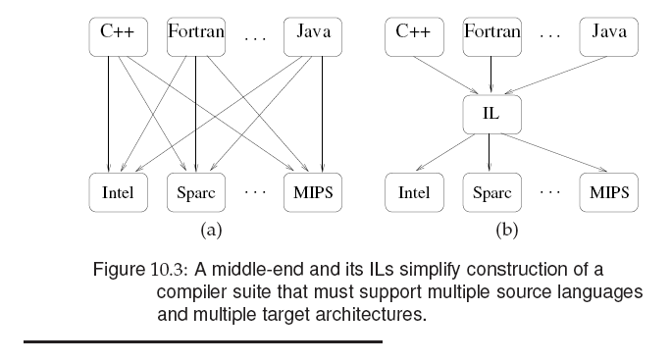

Slide 7
Issues in Code Generation
Code Selection:
  Deciding which sequence of target machine instructions will be used to implement each phrase in the source language.
Storage Allocation
  Deciding the storage address for each variable in the source program. (static allocation, stack allocation etc.)
Register Allocation (for register-based machines)
  How to use registers efficiently to store intermediate results.
Code Scheduling
  The order in which the generated instructions are executed
Notes:
Code selection:
Forskellige måder at lave et while loop på fx (for eller while i C fx)

Slide 8
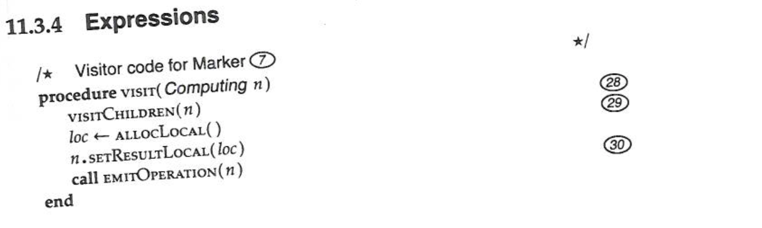
Code Emmision
Generating the actual instructions is usually called emission
  a CodeGenVisitor emits instructions
Example:
  MethodBodyVisitor.visit(Plus)
    visit(E1)
    visit(E2)
    emit("iadd\n")
+
E1
E2

Slide 9
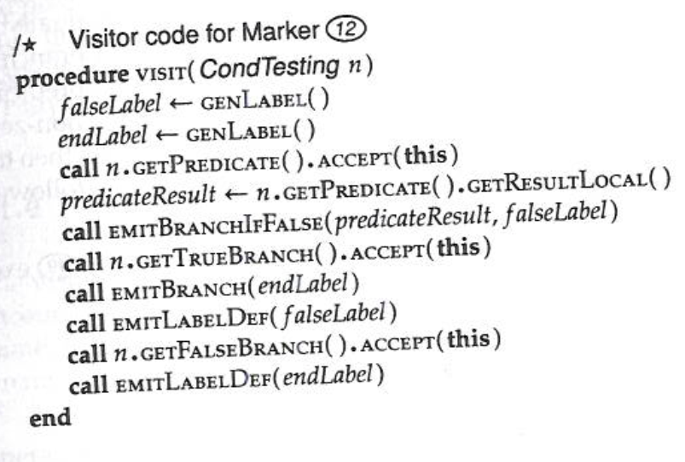
Code Templates
visit [if E then C1 else C2] =
  visit [E]
  JUMPIFFALSE fl
  visit [C1]
  JUMP el
  fl: visit [C2]
  el:
E
If
C1
E
C1
C2
fl:
C2
el:

Slide 10
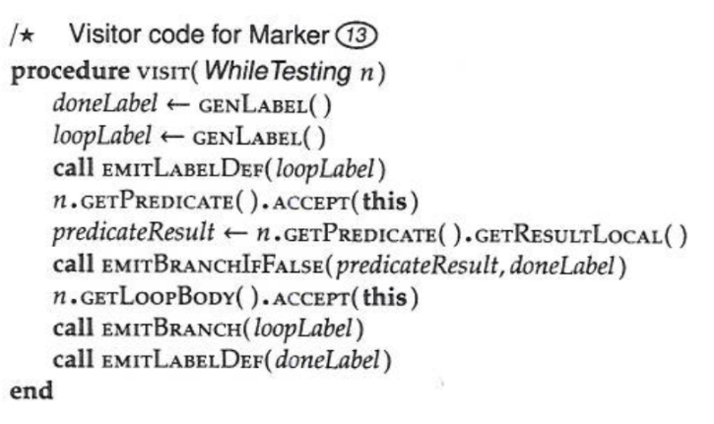
Code Templates
While Command:
visit [while E do C] =
  l: visit [E]
  JUMPIFFALSE d
  visit[C]
  JUMP l
  d:
E
C
Alternative While Command code template:
visit [while E do C] =
  JUMP h
  l: visit [C]
  h: visit[E]
  JUMPIFTRUE l
C
E
E
C

Slide 11
Backpatching Example
public Object WhileCommand (
WhileCommand com,Object arg) {
short j = nextInstrAddr;
emit(Instruction.JUMPop, 0,
Instruction.CBr,0);
short g = nextInstrAddr;
com.C.visit(this,arg);
short h = nextInstrAddr;
code[j].d = h;
com.E.visit(this,arg);
emit(Instruction.JUMPIFop, 1,
Instruction.CBr,g);
return null;
}
dummy address
backpatch
execute [while E do C] =
  JUMP h
  g: execute [C]
  h: evaluate[E]
  JUMPIF(1) g
Notes:
Ved ikke hvor mange C der er, så fixer det senere

Slide 12
Code Template: Global Procedure
elaborate [proc I () ~ C] =
JUMP g
  e: execute [C]
  RETURN(0) 0
  g:
C
execute [I ()] =
  CALL(SB) e
Notes:
Gider ikke køre koden når vi definere den, kun når vi kalder den

Slide 13
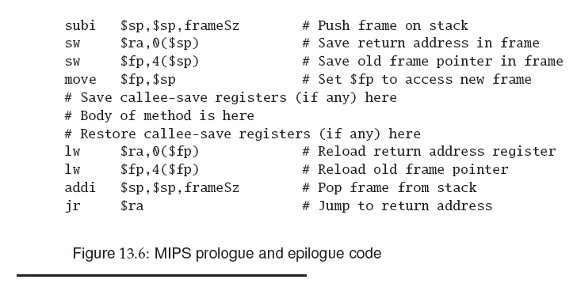

Slide 14
Register Allocation
A compiler generating code for a register machine needs to pay attentention to register allocation as this is a limited ressource
In routine protocol
  Allocate arg1 in R1, arg2 in R2 .. Result in R0
  But what if there are more args than regs?
In evaluation of expressions
  On MIPS all calculations take place in regs
  Reduce traffic between memory and regs

Slide 15
Code scheduling
Modern computers are pipelined
  Instructions are processed in stages
  Instructions take different time to execute
  If result from previous instruction is needed but not yet ready then we have a stalled pipeline
  Delayed load
    Load from memory takes 2, 10 or 100 cycles
  Also FP instructions takes time
Notes:
FP = floating point

Slide 16
Reg allocation and Code Scheluling
Reg allocations algorithms try to minimize the number of regs used
May conflict with pipeline architecture
  Using more regs than strictly necessary may avoid pipeline stalls
Solution
  Integrated register allocator and code scheduler

Slide 17
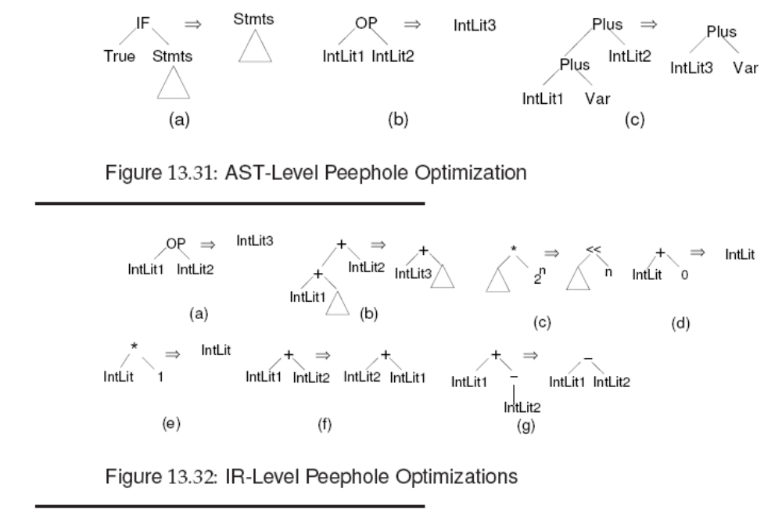

Slide 18
